Slide 1
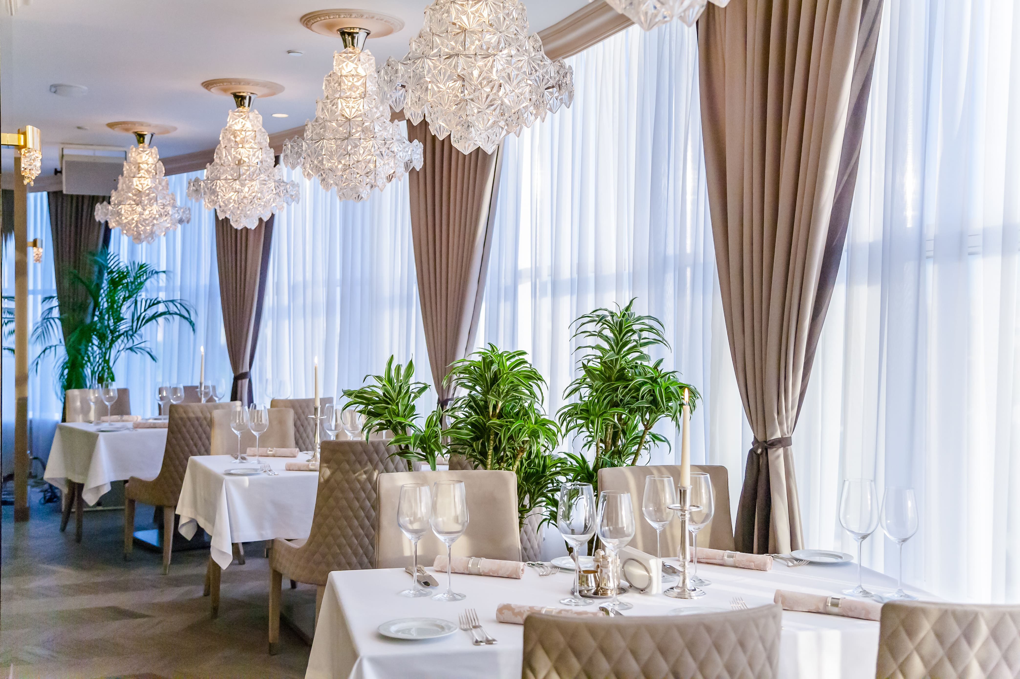
Restaurant Sales Overview
This report provides a snapshot of restaurant sales performance, highlighting key metrics and item-level revenue.
Key Performance Indicators (KPIs):
Average Price per Item: $6.55
Average Quantity per Order: 3.01
Total Revenue: $340,494
Top sales this year:
1) Pasta Alfredo: This item significantly leads in sales, generating over $40,000.
2) Grilled Chicken: Closely follows Pasta Alfredo, also bringing in over $40,000 in revenue.
3) Salmon: A strong third contender, with revenue in the high $20,000s.
4) Vegetarian Platter: Another significant contributor, with sales in the low $20,000s.

Slide 2
Restaurant Sales Overview
This report provides a snapshot of restaurant sales performance, highlighting key metrics and item-level revenue.
Key Performance Indicators (KPIs):
Average Price per Item: $6.55
Average Quantity per Order: 3.01
Total Revenue: $340,494
Top sales this year:
1) Pasta Alfredo: This item significantly leads in sales, generating over $40,000.
2) Grilled Chicken: Closely follows Pasta Alfredo, also bringing in over $40,000 in revenue.
3) Salmon: A strong third contender, with revenue in the high $20,000s.
4) Vegetarian Platter: Another significant contributor, with sales in the low $20,000s.

Slide 3
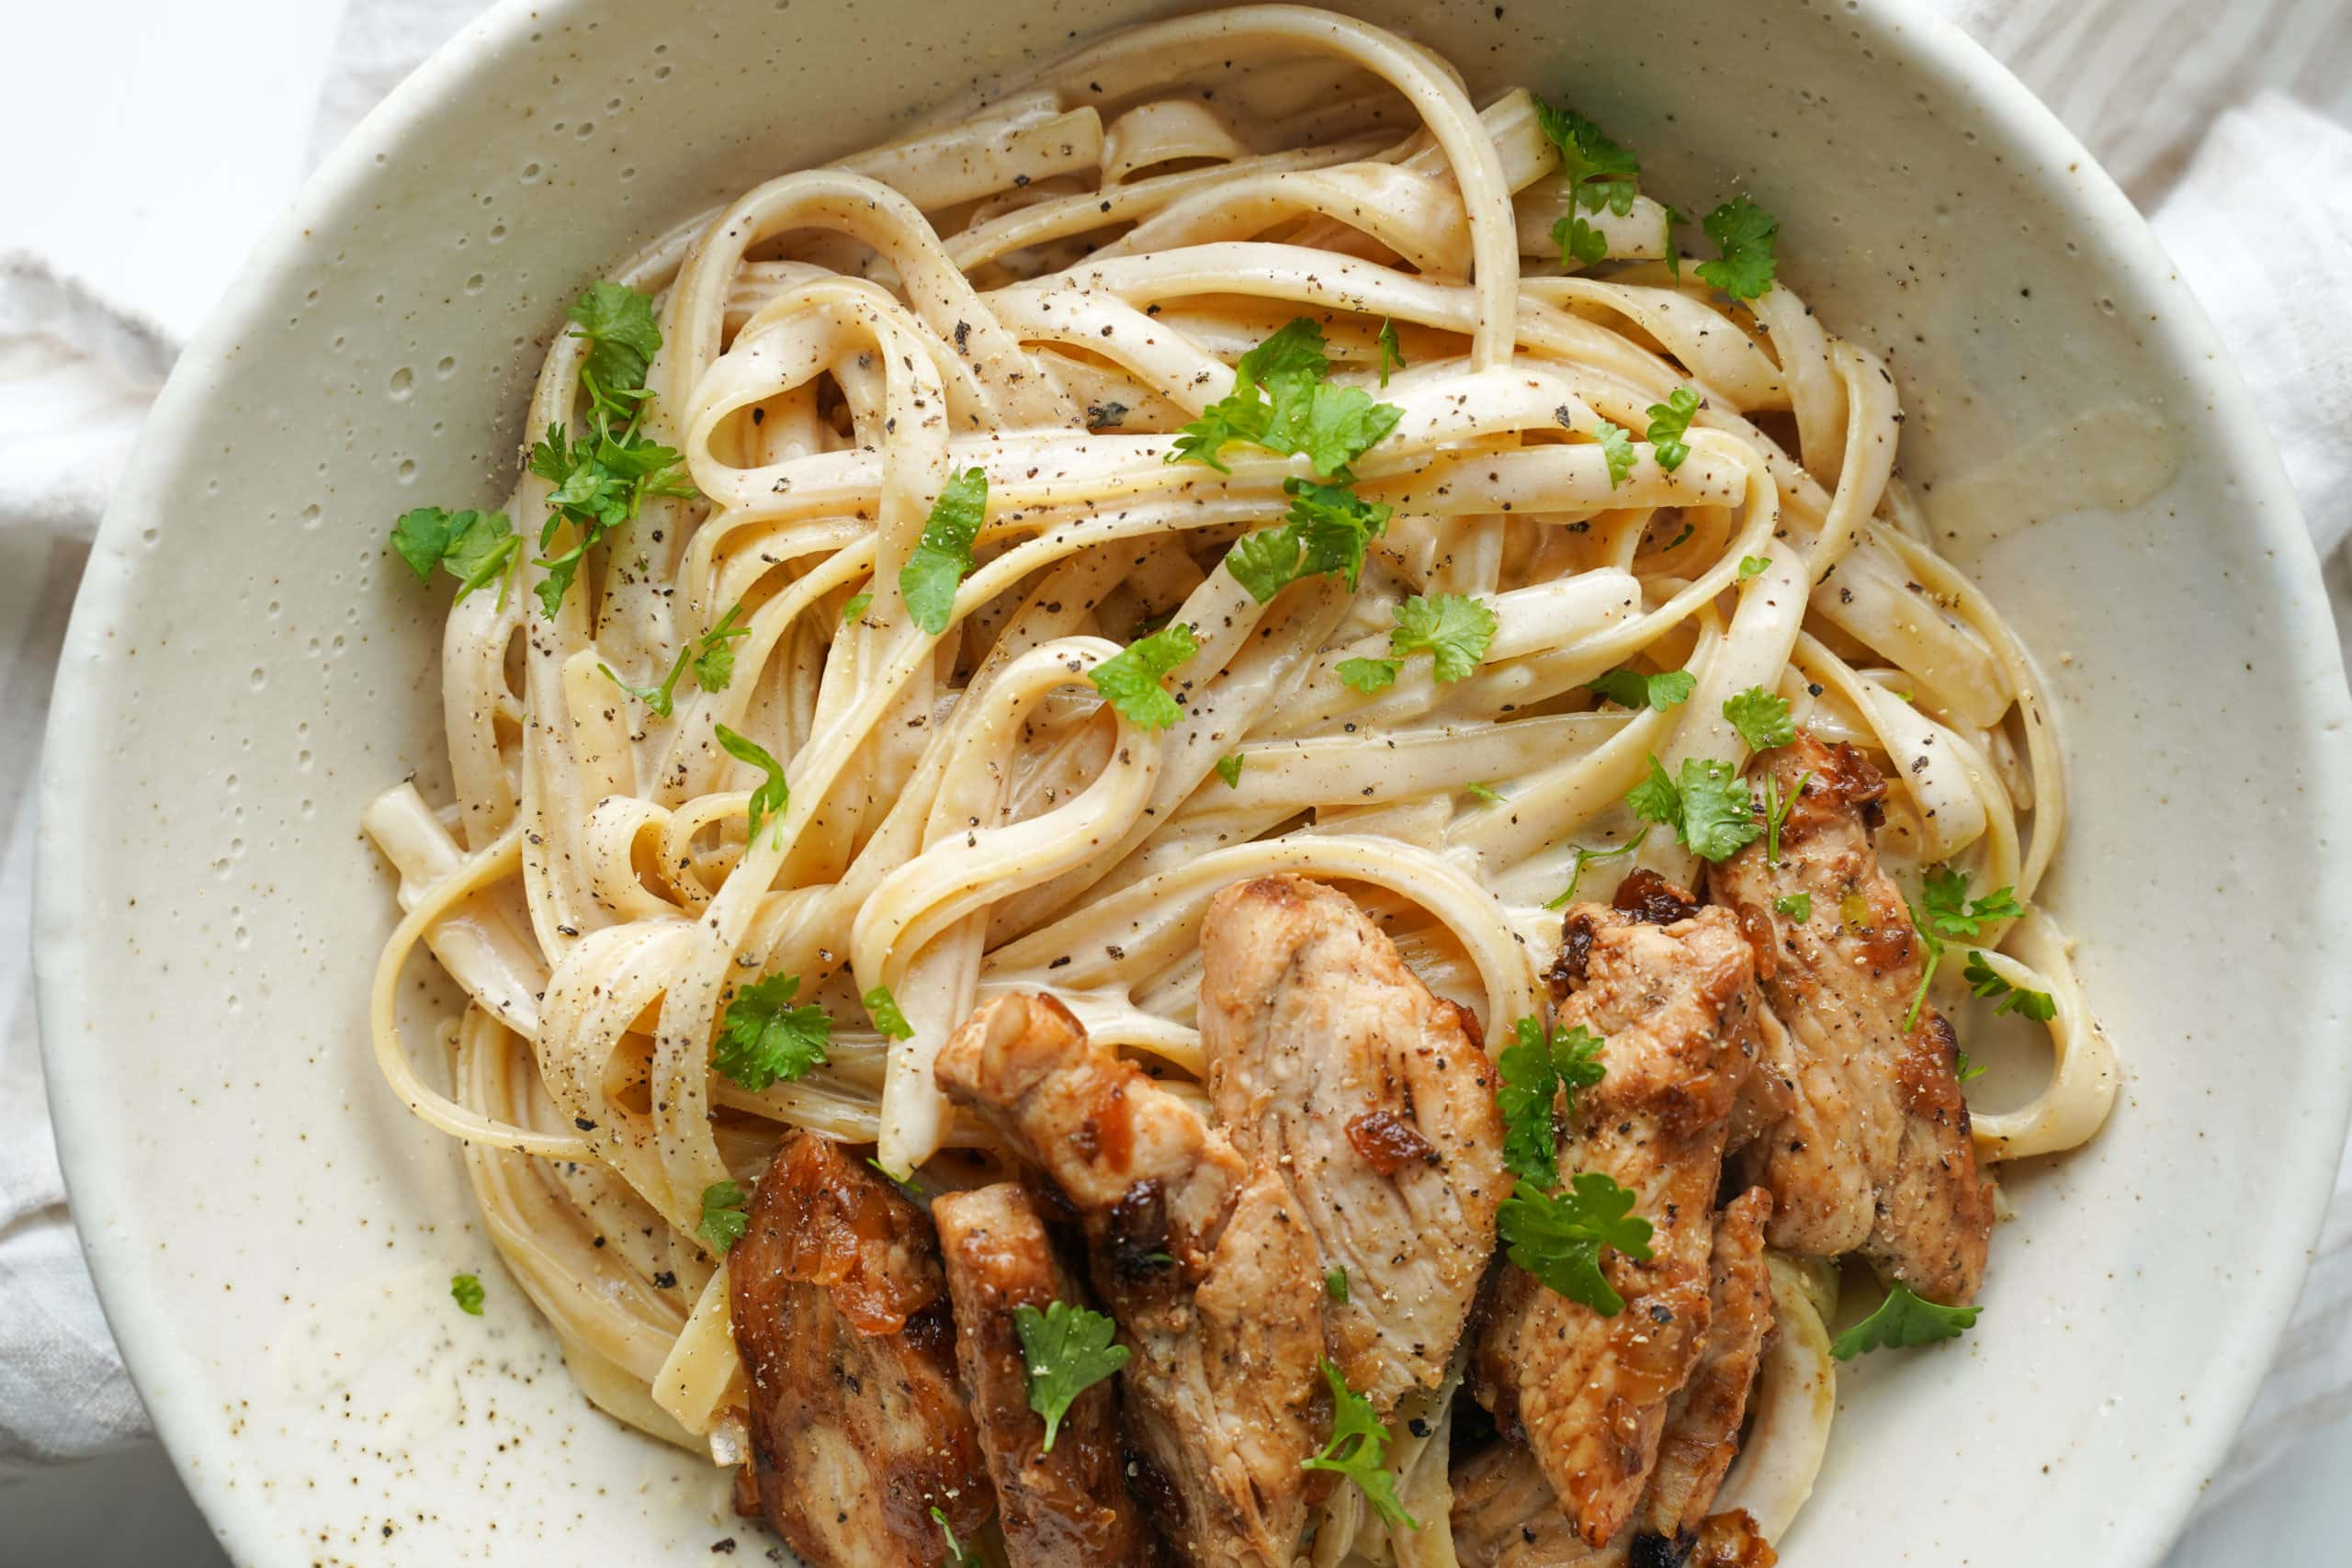
Top 1: Pasta Alfredo
Average Price: $12.00
Average Quantity per Order: 3.11
Sum of Quantity Ordered: 3,361 units
Revenue: $40,332
Observation: This is the highest revenue-generating item, despite having a lower average price than Steak or Salmon. Its high revenue is driven by a significantly higher quantity sold (3,361 units), indicating strong customer demand and perhaps a good price-to-value perception.

Slide 4
Top 1: Pasta Alfredo
Average Price: $12.00
Average Quantity per Order: 3.11
Sum of Quantity Ordered: 3,361 units
Revenue: $40,332
Observation: This is the highest revenue-generating item, despite having a lower average price than Steak or Salmon. Its high revenue is driven by a significantly higher quantity sold (3,361 units), indicating strong customer demand and perhaps a good price-to-value perception.

Slide 5
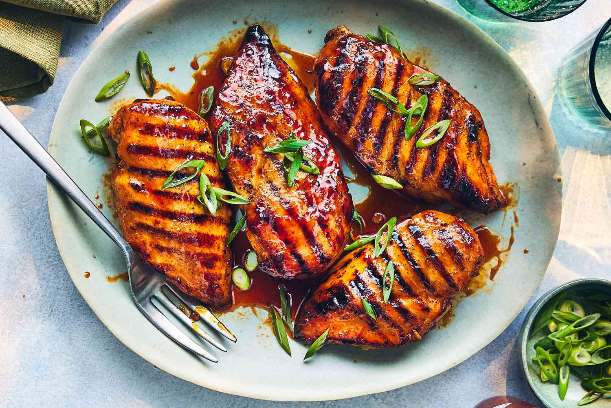

Slide 6
Top 2: Grilled Chicken
Average Price: $15.00
Average Quantity per Order: 3.03
Sum of Quantity Ordered: 2,677 units
Revenue: $40,155
Observation: Very close to Pasta Alfredo in total revenue, making it the second highest revenue generator. It achieves this with a slightly higher average price and a slightly lower quantity sold compared to Pasta Alfredo. This suggests it's a very popular and profitable item.

Slide 7
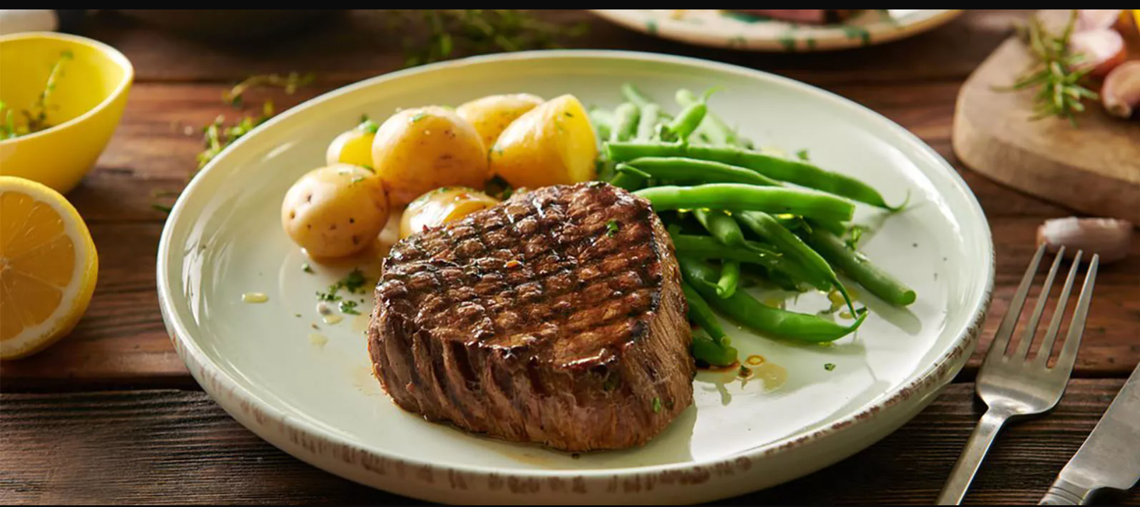

Slide 8
3. Steak
Average Price: $20.00
Average Quantity per Order: 3.08
Sum of Quantity Ordered: 1,904 units
Revenue: $38,080
Observation: The highest-priced item among the top 4, and the third in terms of overall revenue. It generates substantial revenue with a lower quantity sold compared to Pasta Alfredo and Grilled Chicken, indicating its premium price point contributes significantly to its total sales.

Slide 9
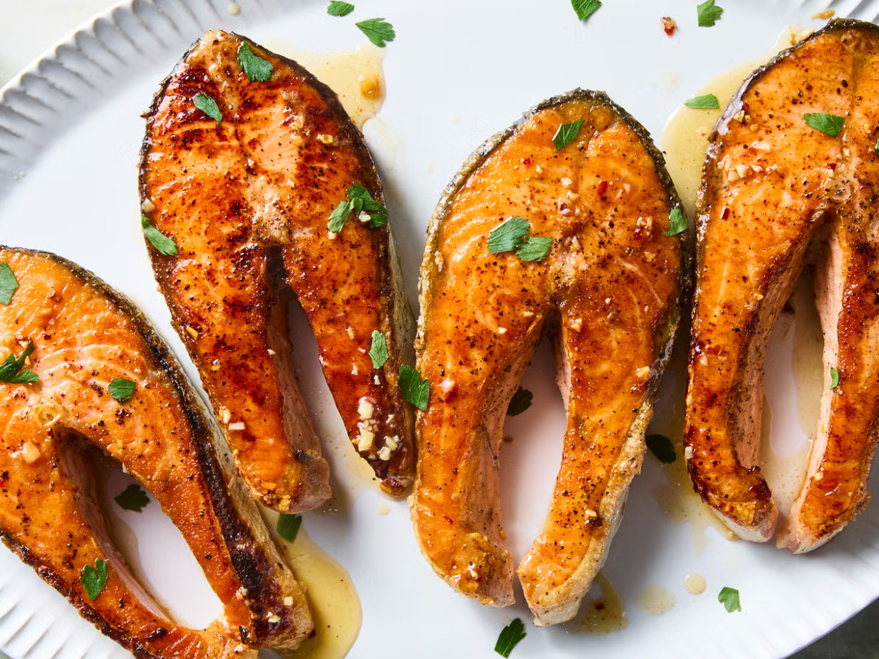

Slide 10
4. Salmon
Average Price: $18.00
Average Quantity per Order: 2.99
Sum of Quantity Ordered: 1,372 units
Revenue: $24,696
Observation: The fourth highest revenue generator. While its average price is lower than Steak, its total revenue is noticeably lower due to a significantly lower quantity sold (1,372 units) compared to the other top items. It still represents a strong performer, likely appealing to a specific segment of customers.

Slide 11
